Slide 1
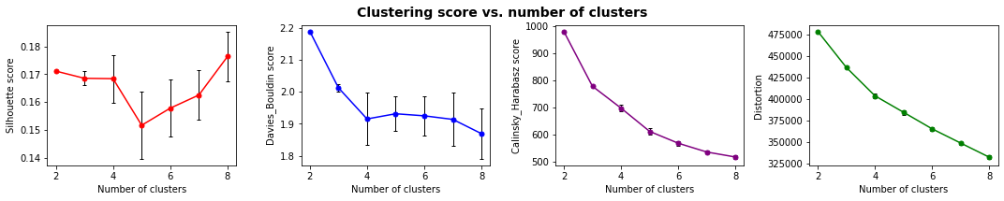
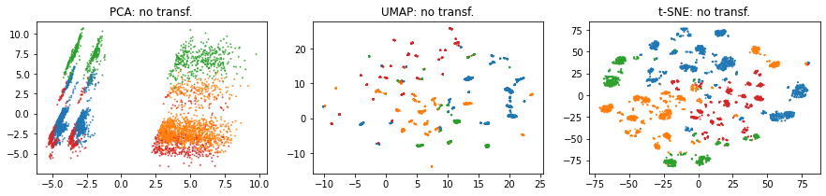
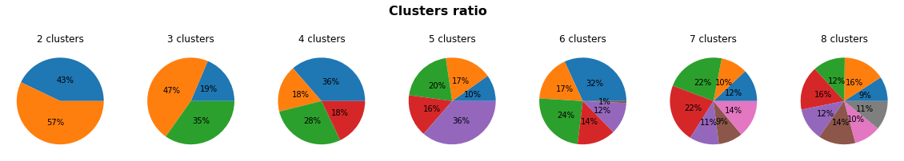
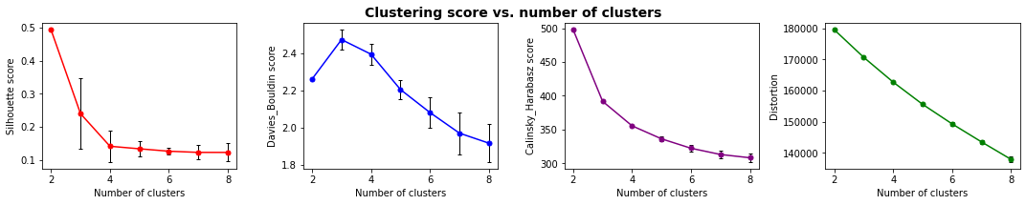
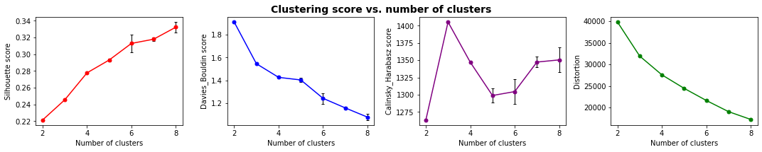
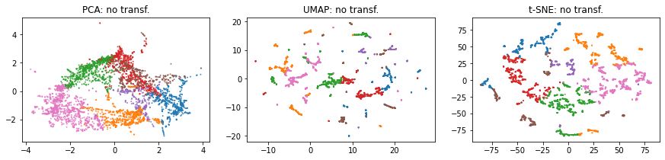
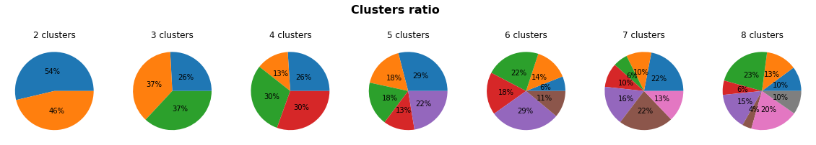
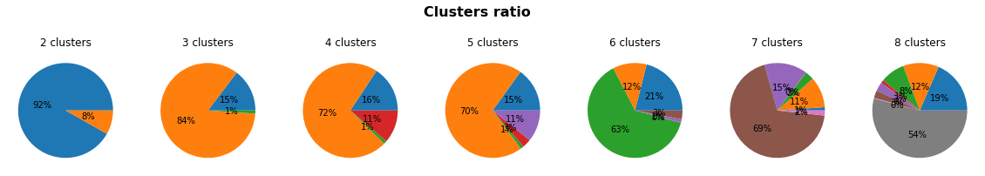
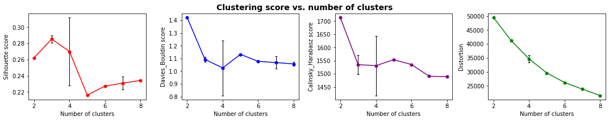
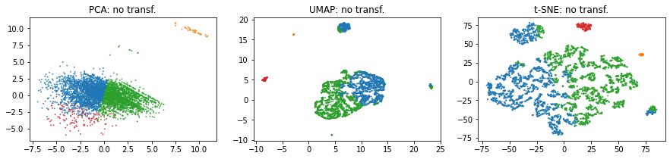
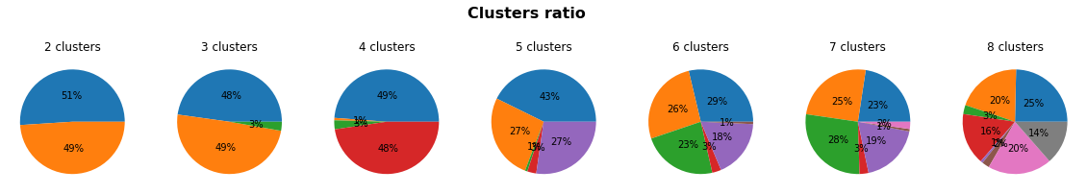
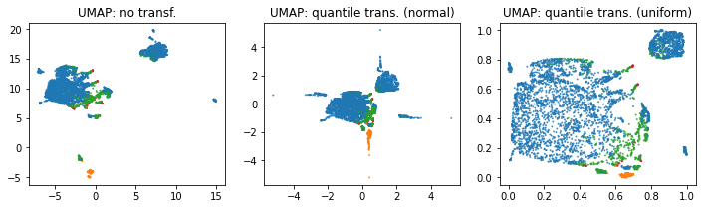
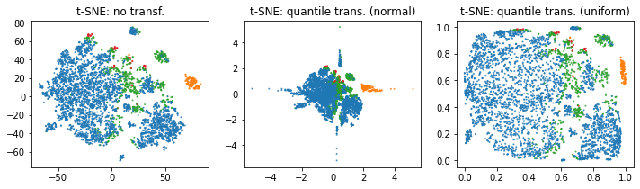
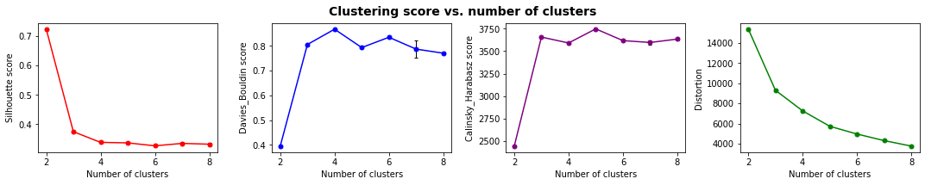
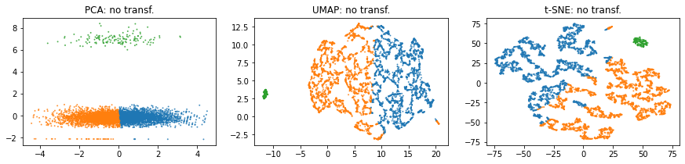
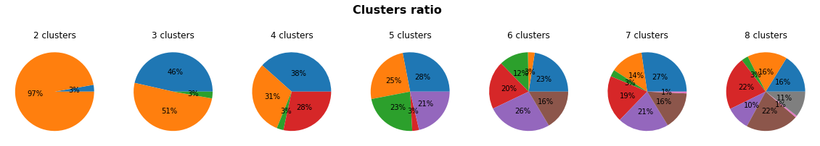
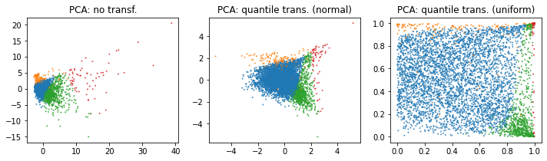
df1 : toutes les colonnes 5000 lignes
1_1, All + quantile transformer - > le moment de la dernière commande et le prix des commandes ne sont pas retenus par le clustering
1_1, All + quantile transformer
2_1, All RFM sauf payments + quantile transformer
2_3, Selection RFM + quantile transformer

Slide 2
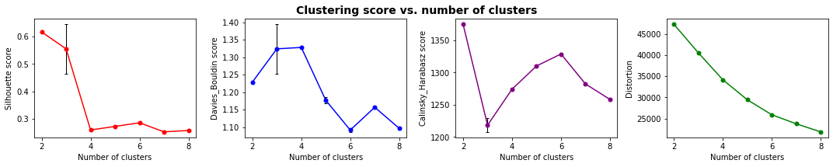
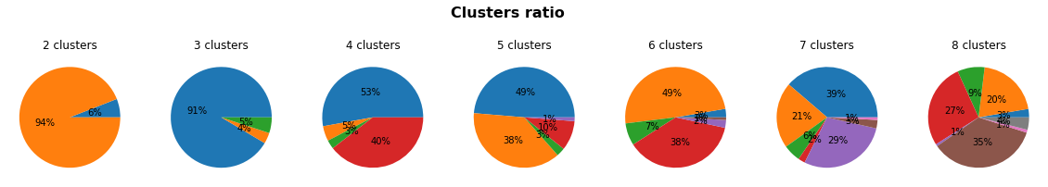
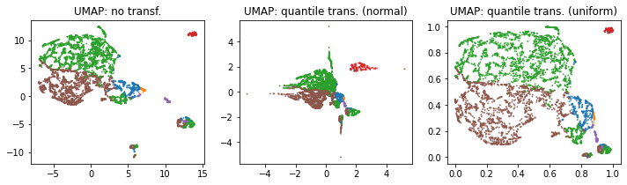
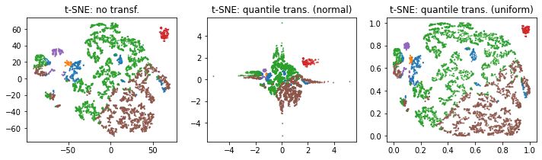
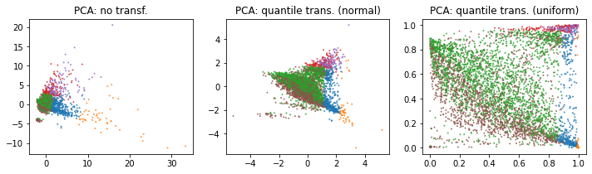
df2 : colonnes RFM 5000 lignes
['time_since_last_purch', 'time_since_first_purch', 'tot_nb_deliv_ord', 'tot_nb_ord', 'single_purch', 'mean_nb_items_per_ord', 'tot_nb_items', 'mean_freight_val_per_order', 'tot_freight_val', 'mean_price_per_order', 'tot_price', 'avg_freight_payval_ratio', 'mean_pay_value_per_order', 'tot_pay_value']

Slide 3
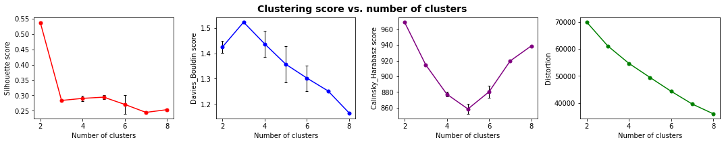
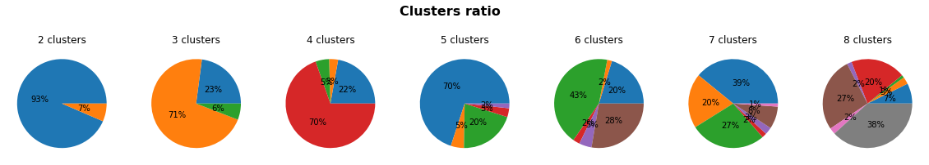
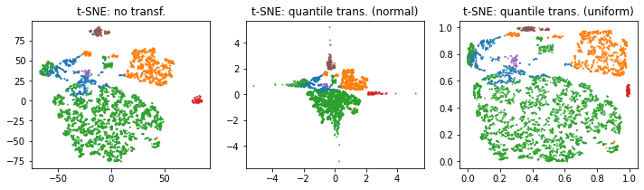
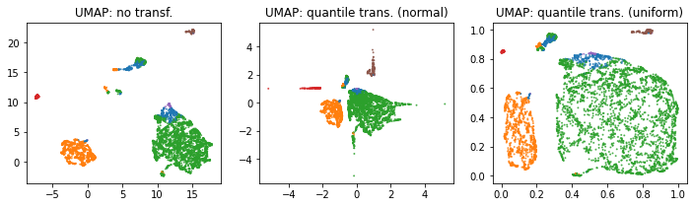
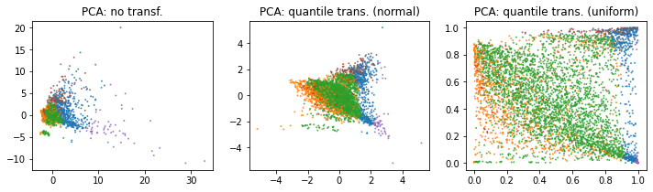
df2bis : colonnes RFM + paytype 5000 lignes
['time_since_last_purch', 'time_since_first_purch', 'tot_nb_deliv_ord', 'tot_nb_ord', 'single_purch', 'mean_nb_items_per_ord', 'tot_nb_items', 'paytype_not_defined_tot_nb', 'paytype_boleto_tot_nb', 'paytype_voucher_tot_nb', 'paytype_debit_card_tot_nb', 'paytype_credit_card_tot_nb', 'mean_pay_install', 'mean_freight_val_per_order', 'tot_freight_val', 'mean_price_per_order', 'tot_price', 'avg_freight_payval_ratio', 'mean_pay_value_per_order', 'tot_pay_value']

Slide 4
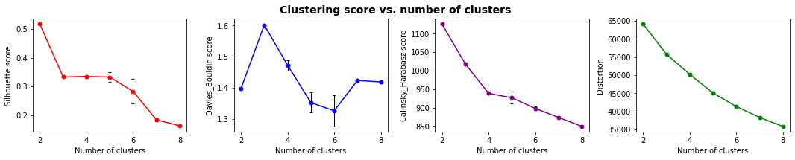
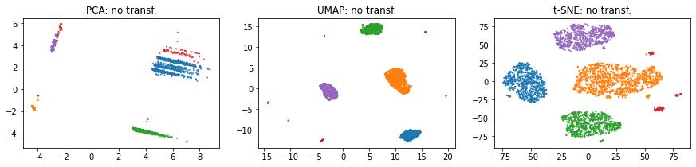
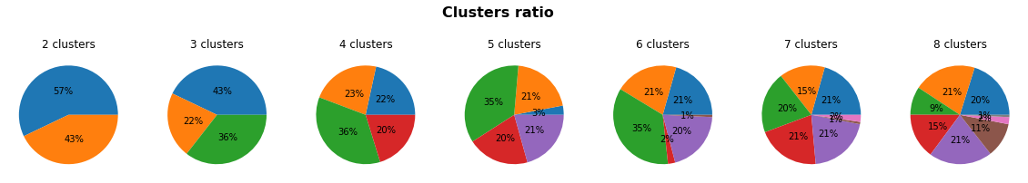
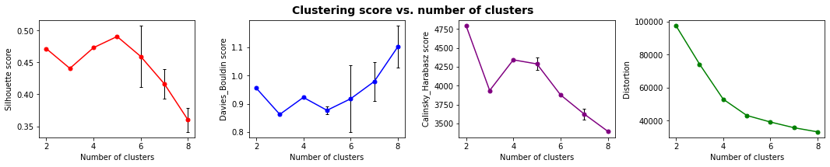
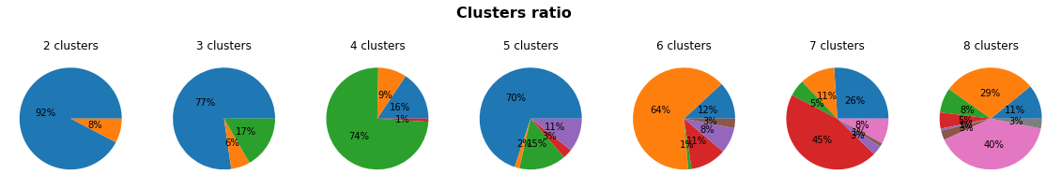
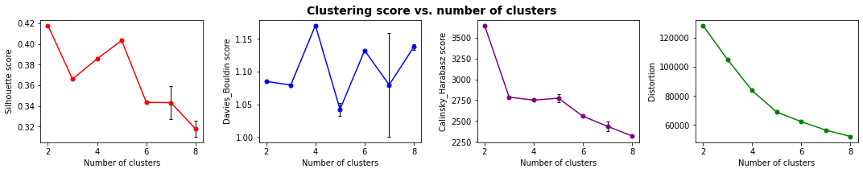
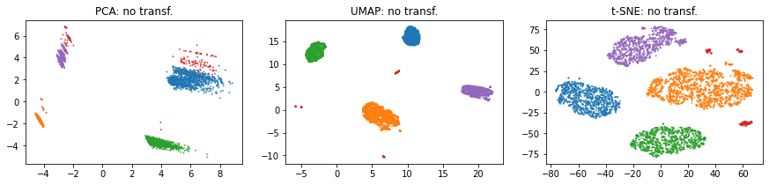
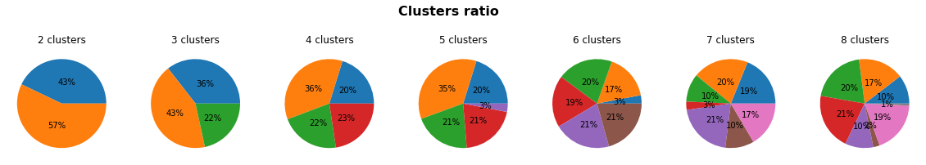
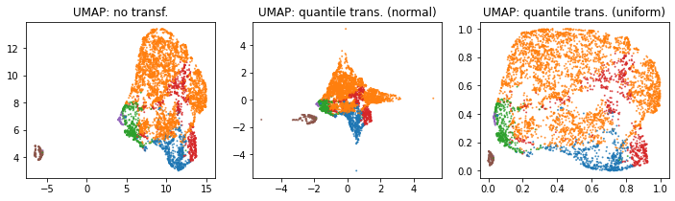
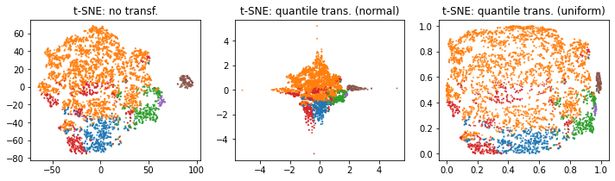
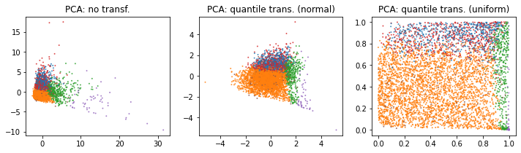
df3 : colonnes prod spec + satisfaction + monetary 5000 lignes
3_3, Selection prod_spec, rev, monet + quantile transformer
3_1, Allprod_spec, rev, monet + quantile transformer
['mean_prod_wei_g', 'nb_not_rec_orders', 'tot_comment_length', 'mean_rev_score', 'mean_freight_val_per_order', 'mean_prod_descr_length', 'mean_comment_length', 'mean_price_per_order', 'mean_ship_delay', 'mean_pay_value_per_order', 'tot_freight_val', 'tot_price', 'tot_pay_value', 'avg_freight_payval_ratio', 'mean_prod_vol_cm3', 'mean_ship_time']]

Slide 5
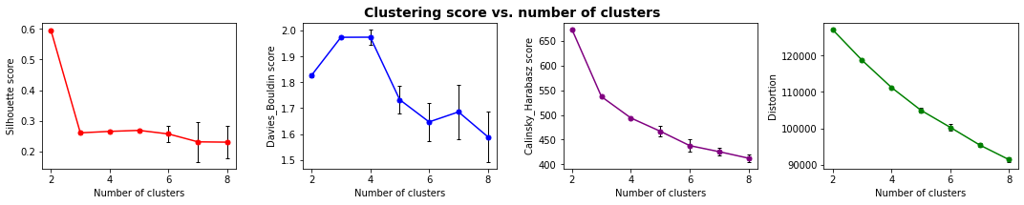
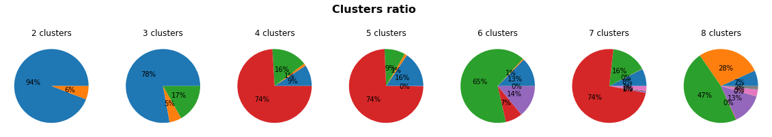
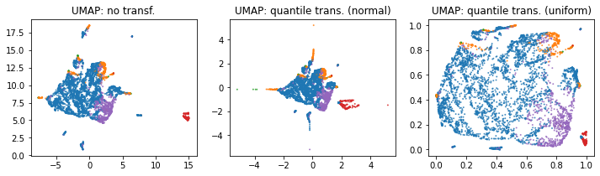
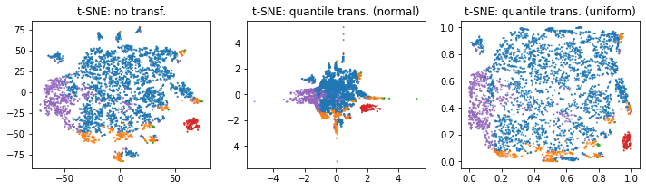
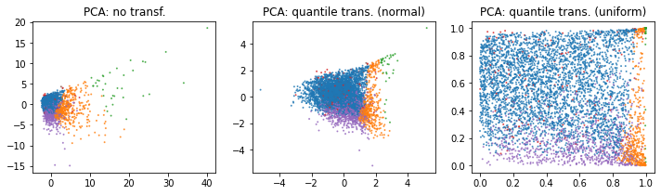
df3bis : colonnes prod spec + cat + satisfaction + monetary 5000 lignes
['tot_pay_value', 'cat_furniture_tot_nb', 'cat_fashion_tot_nb', 'cat_electronics_tot_nb', 'mean_price_per_order', 'mean_ship_delay', 'cat_miscellaneous_tot_nb', 'cat_home_tot_nb', 'mean_pay_value_per_order', 'cat_unknown_tot_nb', 'mean_ship_time', 'cat_books_tot_nb', 'cat_leisure_tot_nb', 'tot_comment_length', 'cat_hygiene_tot_nb', 'mean_prod_vol_cm3', 'cat_multimedia_tot_nb', 'mean_rev_score', 'mean_prod_descr_length', 'mean_comment_length', 'cat_diy_tot_nb', 'mean_prod_wei_g', 'nb_not_rec_orders', 'mean_freight_val_per_order', 'cat_food_tot_nb', 'tot_freight_val', 'tot_price', 'cat_office_tot_nb', 'avg_freight_payval_ratio']

Slide 6
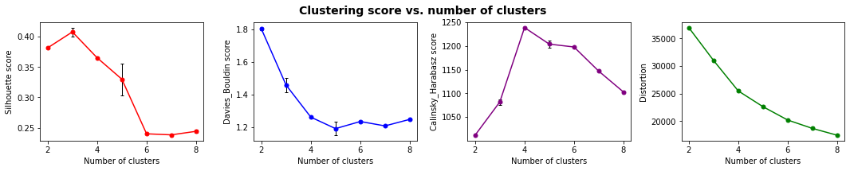
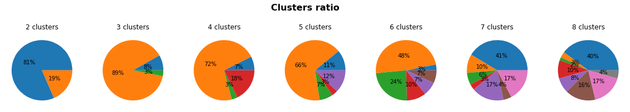
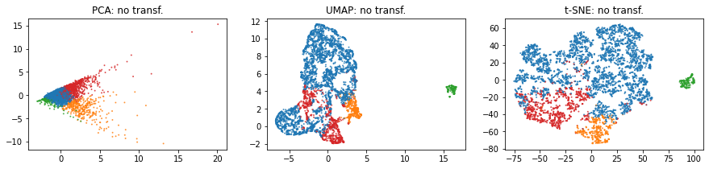
df4 : colonnes 5000 lignes
['avg_freight_payval_ratio', 'tot_freight_val', 'mean_rev_score', 'tot_comment_length', 'mean_ship_delay', 'mean_ship_time',
'nb_not_rec_orders', 'mean_prod_wei_g', 'mean_prod_vol_cm3']

Slide 7
Quantile normalization (norm)
Toutes les variables (produit, paiement, région, satisfaction, rfm)
RFM
Produit satisfaction valeur

Slide 8
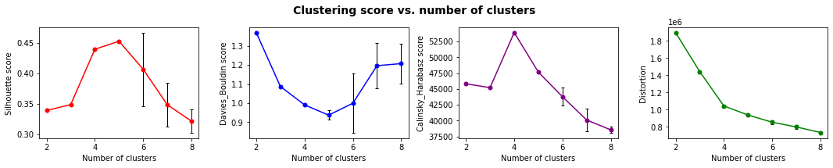
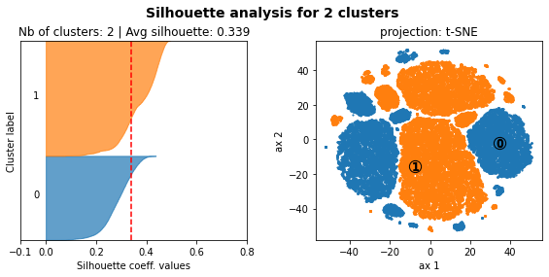
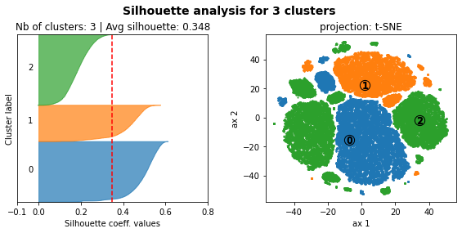
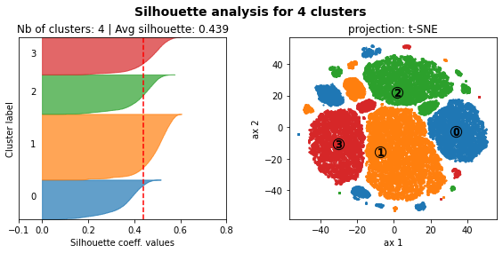



Sélection A, toute la base de données Product related features: 'mean_prod_descr_length', 'mean_prod_wei_g'
Shipping Related features: 'avg_freight_payval_ratio', 'mean_ship_time'
Satisfaction related features: 'tot_comment_length', 'mean_rev_score',
RFM related features (Recency, Frequency, Monetary): 'time_since_last_purch', 'tot_price', 'tot_nb_ord', 'mean_nb_items_per_ord'

Slide 9








Sélection A, toute la base de données Product related features: 'mean_prod_descr_length', 'mean_prod_wei_g'
Shipping Related features: 'avg_freight_payval_ratio', 'mean_ship_time'
Satisfaction related features: 'tot_comment_length', 'mean_rev_score',
RFM related features (Recency, Frequency, Monetary): 'time_since_last_purch', 'tot_price', 'tot_nb_ord', 'mean_nb_items_per_ord'
Retiré ces variables qui ne peuvent pas
être correctement normalisées

Slide 10















df1_2, UMAP 10 composantes '

Slide 11



0: commandes reçues, mécontents
1: commandes non reçues, mécontents
2: petites commandes, satisfaits
3: grosses commandes, satisfaits
Selection B (échantillon strat de 3000 clients) + Power transformer (yeo)

Slide 12


0: commandes non reçues, mécontents
1: petites commandes, satisfaits
2: grosses commandes, satisfaits
3: contents et impliqués
Selection B (échantillon strat de 3000 clients) + Quantile transformer(quant_uni)

Slide 13


0: commandes non reçues, mécontents
1: petites commandes, satisfaits
2: grosses commandes, satisfaits
3: contents et impliqués
Selection B (échantillon strat de 3000 clients) + UMAP 10 composantes

Slide 14
SELECTION A | satisfaction, shipping, product specif,, monetary, recency and frequency
Product related features: 'mean_prod_descr_length', 'mean_prod_wei_g‘, ‘mean_prod_vol_cm3’ Shipping Related features: 'mean_ship_delay', 'nb_not_rec_orders‘, ‘avg_freight_payval_ratio’ Satisfaction related features: 'tot_comment_length', 'mean_rev_score', RFM related features: 'time_since_last_purch', 'tot_price', 'mean_nb_items_per_ord‘, 'tot_nb_deliv_ord’ Payment modalities: 'mean_pay_install'
SELECTION B | customer’s satisfaction, shipping and product/order specificities Product/order related features:'mean_prod_descr_length', 'mean_prod_wei_g‘, ‘mean_prod_vol_cm3’, 'mean_nb_items_per_ord’ Shipping Related features: 'avg_freight_payval_ratio', 'mean_ship_delay‘, Satisfaction related features: 'tot_comment_length', 'mean_rev_score',
SELECTION C | monetary aspects, recency and frequency RFM related features: 'time_since_last_purch', 'tot_price', 'mean_nb_items_per_ord‘, 'tot_nb_deliv_ord’ Payment modalities: 'mean_pay_install'
'cust_region', 'mean_nb_items_per_ord', 'tot_nb_items', 'mean_freight_val_per_order', 'tot_freight_val', 'mean_price_per_order', 'tot_price', 'tot_nb_deliv_ord', 'avg_freight_payval_ratio', 'tot_nb_ord', 'mean_ship_delay', 'mean_ship_time', 'single_purch', 'nb_not_rec_orders', 'time_since_last_purch', 'time_since_first_purch', 'mean_prod_vol_cm3', 'tot_comment_length', 'mean_prod_descr_length', 'mean_prod_wei_g', 'mean_comment_length', 'mean_rev_score', 'mean_pay_value_per_order', 'tot_pay_value',
'paytype_not_defined_tot_nb', 'paytype_boleto_tot_nb', 'mean_pay_install', 'paytype_voucher_tot_nb', 'paytype_debit_card_tot_nb', 'paytype_credit_card_tot_nb',
'cat_multimedia_tot_nb', 'cat_office_tot_nb', 'cat_leisure_tot_nb', 'cat_home_tot_nb', 'cat_food_tot_nb', 'cat_unknown_tot_nb', 'cat_diy_tot_nb', 'cat_electronics_tot_nb', 'cat_furniture_tot_nb', 'cat_hygiene_tot_nb', 'cat_fashion_tot_nb', 'cat_miscellaneous_tot_nb', 'cat_books_tot_nb'

Slide 15






SELECTION A | satisfaction, shipping, product specif,, monetary, recency and frequency
Product related features: 'mean_prod_descr_length', 'mean_prod_wei_g‘, ‘mean_prod_vol_cm3’ Shipping Related features: 'mean_ship_delay', 'nb_not_rec_orders‘, ‘avg_freight_payval_ratio’ Satisfaction related features: 'tot_comment_length', 'mean_rev_score', RFM related features: 'time_since_last_purch', 'tot_price', 'mean_nb_items_per_ord‘, 'tot_nb_deliv_ord’ Payment modalities: 'mean_pay_install'

Slide 16





























Toute la base + standardscaler -> échantillonnage impossible, problème de stabilité, représentativité inégale des variables
SELECTION A | satisfaction, shipping, product specif,, monetary, recency and frequency
Product related features: 'mean_prod_descr_length', 'mean_prod_wei_g‘, ‘mean_prod_vol_cm3’ Shipping Related features: 'mean_ship_delay', 'nb_not_rec_orders‘, ‘avg_freight_payval_ratio’ Satisfaction related features: 'tot_comment_length', 'mean_rev_score', RFM related features: 'time_since_last_purch', 'tot_price', 'mean_nb_items_per_ord‘, 'tot_nb_deliv_ord’ Payment modalities: 'mean_pay_install'
Cluster 0: grosses commandes et facilités de paiment
Cluster 1: petites et moyennes commandes
Cluster 2: commandes non reçues
Cluster 0: client moyen
Cluster 1: mécontents (retard de livraison)
Cluster 2: grosses commandes et facilités de paiement
Cluster 3: mécontents (non reçu)
Cluster 0: petites et moyennes commandes
Cluster 1: gros montant petits articles
Cluster 2: gros montants gros articles
Cluster 3: non reçus mécontents
Cluster 4: livraison retardée mécontents

Slide 17









échantillon strat de 3000 + quant_norm + UMAP 6
SELECTION A | satisfaction, shipping, product specif,, monetary, recency and frequency
Product related features: 'mean_prod_descr_length', 'mean_prod_wei_g‘, ‘mean_prod_vol_cm3’ Shipping Related features: 'mean_ship_delay', 'nb_not_rec_orders‘, ‘avg_freight_payval_ratio’ Satisfaction related features: 'tot_comment_length', 'mean_rev_score', RFM related features: 'time_since_last_purch', 'tot_price', 'mean_nb_items_per_ord‘, 'tot_nb_deliv_ord’ Payment modalities: 'mean_pay_install'
Refaire en prenant 5000
Et 5 clusters
Cluster 0: enthousiastes
Cluster 1: mécontents (retard de livraison)
Cluster 2: content (grosses commandes)
Cluster 3: content (petites commandes)
Cluster 4: mécontent (sans retard)
Cluster 5: indécis (article non reçu) et nombreux articles
Cluster 6: mécontents (article non reçu) et nombreux articles

Slide 18




échantillon strat de 3000 + quant_norm + UMAP 13
SELECTION A | satisfaction, shipping, product specif, monetary, recency and frequency
Product related features: 'mean_prod_descr_length', 'mean_prod_wei_g‘, ‘mean_prod_vol_cm3’ Shipping Related features: 'mean_ship_delay', 'nb_not_rec_orders‘, ‘avg_freight_payval_ratio’ Satisfaction related features: 'tot_comment_length', 'mean_rev_score', RFM related features: 'time_since_last_purch', 'tot_price', 'mean_nb_items_per_ord‘, 'tot_nb_deliv_ord’ Payment modalities: 'mean_pay_install'
Avec 6 composantes, les échantillons sont plus
Représentatifs de l’ensemble du dataset

Slide 19

















SELECTION A | satisfaction, shipping, product specif, monetary, recency and frequency
Product related features: 'mean_prod_descr_length', 'mean_prod_wei_g‘, ‘mean_prod_vol_cm3’ Shipping Related features: 'mean_ship_delay', 'nb_not_rec_orders‘, ‘avg_freight_payval_ratio’ Satisfaction related features: 'tot_comment_length', 'mean_rev_score', RFM related features: 'time_since_last_purch', 'tot_price', 'mean_nb_items_per_ord‘, 'tot_nb_deliv_ord’ Payment modalities: 'mean_pay_install'
7 segments
échantillon strat de 3000 + stand+ UMAP 6
échantillon strat de 3000 + quant_norm + UMAP 6

Slide 20










norm + stand
norm
stand + norm
stand
minmax
stand + norm + stand
stand + norm + stand
quant_norm
yeo
robust

Slide 21















5 clusters (3000)
SELECTION B | customer’s satisfaction, shipping and product/order specificities (3000) Product/order related features:'mean_prod_descr_length', 'mean_prod_wei_g‘, ‘mean_prod_vol_cm3’, 'mean_nb_items_per_ord’ Shipping Related features: 'avg_freight_payval_ratio', 'mean_ship_delay‘, Satisfaction related features: 'tot_comment_length', 'mean_rev_score',

Slide 22







6 clusters (3000)
SELECTION B | customer’s satisfaction, shipping and product/order specificities (3000) Product/order related features:'mean_prod_descr_length', 'mean_prod_wei_g‘, ‘mean_prod_vol_cm3’, 'mean_nb_items_per_ord’ Shipping Related features: 'avg_freight_payval_ratio', 'mean_ship_delay‘, Satisfaction related features: 'tot_comment_length', 'mean_rev_score',

Slide 23













5 clusters (10000)
SELECTION C | monetary aspects, recency and frequency (10 000) RFM related features: 'time_since_last_purch', 'tot_price', 'mean_nb_items_per_ord‘, 'tot_nb_deliv_ord’ Payment modalities: 'mean_pay_install'

Slide 24
6 clusters (10000)
SELECTION C | monetary aspects, recency and frequency (10 000) RFM related features: 'time_since_last_purch', 'tot_price', 'mean_nb_items_per_ord‘, 'tot_nb_deliv_ord’ Payment modalities: 'mean_pay_install'

